Slide 1


Rankings / Research / People / Partnerships

Slide 2

How do we demonstrate we are Canada’s leading faculty of medicine? Through data. From international rankings to research funding and donor support, the new Vitals website at vitals.medicine.utoronto.ca quantifies this Faculty’s impact. These figures will be updated throughout the year to report the most recent data about U of T Medicine.

Slide 3
International Rankings
The Faculty of Medicine at the University of Toronto continues to be ranked the top medical school in Canada, and among the top 20 worldwide. While ranking methodology varies, our strong standing is enabled by our large research output and citations.
#3
2019 National Taiwan University Ranking (Clinical Medicine)
2020 U.S. News & World Report (Clinical Medicine)
2020 Academic Ranking of World Universities (Clinical Medicine)
2019 QS World University Ranking (Medicine)
2020 Academic Ranking of World Universities
#4
#6
#13
#15

Slide 4
Contributions to Physician Supply and Distribution
Source: 2016 Ontario Physician Human Resources Data Centre
U of T is the single largest contributor of physicians in Canada, representing 19% of all newly trained Canadian physicians in 2019. (CAPER 2020). According to the Ontario Physician Human Resources Data Centre (OPHRDC), of all Ontario trained physicians entering practice in this province between 2002 and 2019:
35%
of family physicians who trained in Ontario did so at U of T
of specialists who trained in Ontario did so at U of T
of Ontario trained family physicians and
of specialists in the GTA are U of T graduates
45%
56%
67%

Slide 5
How We Innovate
FY 2016 – FY 2020
259
of 904 new invention disclosures filed at U of T came from Medicine
of 426 new priority patent applications filed by U of T came from Medicine
of 204 US patents issued tied to U of T came from Medicine
of 187 new licenses and options at U of T came from Medicine
of 76 new start-up companies at U of T came from Medicine
63
29
36
13

Slide 6
Research Numbers
U of T Medicine Medicine, including its researchers at TAHSN-affiliated institutes, received nearly $900M in research funding in 2018-19 and saw a 9.8 per cent increase in annual support from Tri-Agency Funding (which includes CIHR, NSERC, SSHRC) from the prior year. Collectively, U of T Medicine receives roughly one-quarter of all Tri-Agency Funding awarded in Canada. With federal funding envelopes remaining relatively static in recent years, U of T Medicine has continued to diversify and increase funding from other sources, including not-for-profit and industry.
10,280
Total Awards
Total Funding (millions)
$821

Slide 7
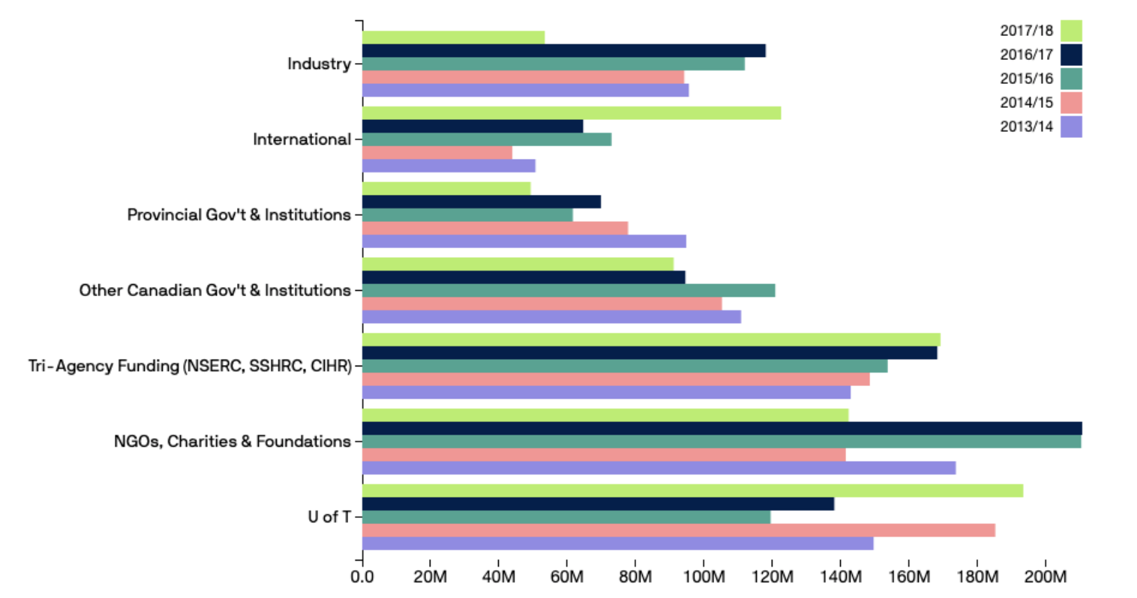
Research Funding Sources

Slide 8
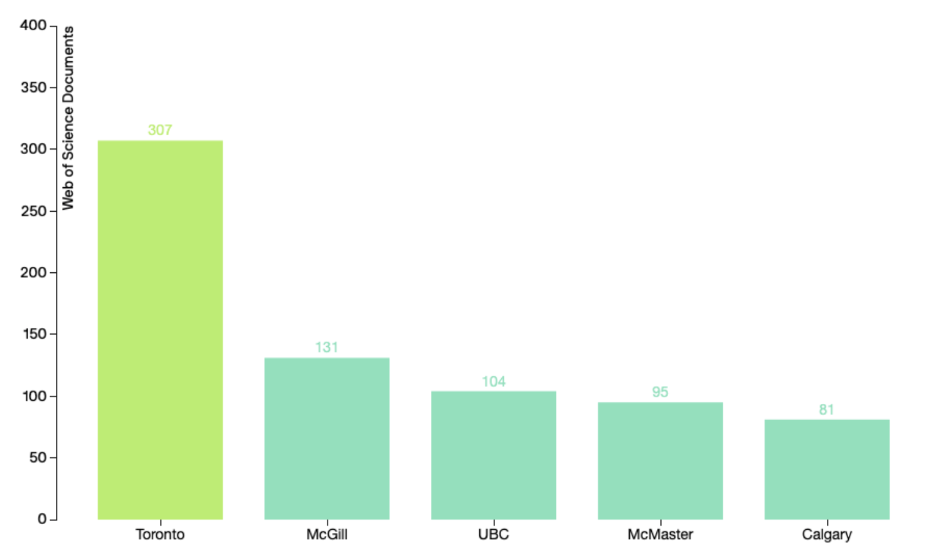
Articles in Top Journals (Canada)
Number of publications in the 50 highest impact journals in medicine and related fields.
Source: Web of Science, 2019

Slide 9
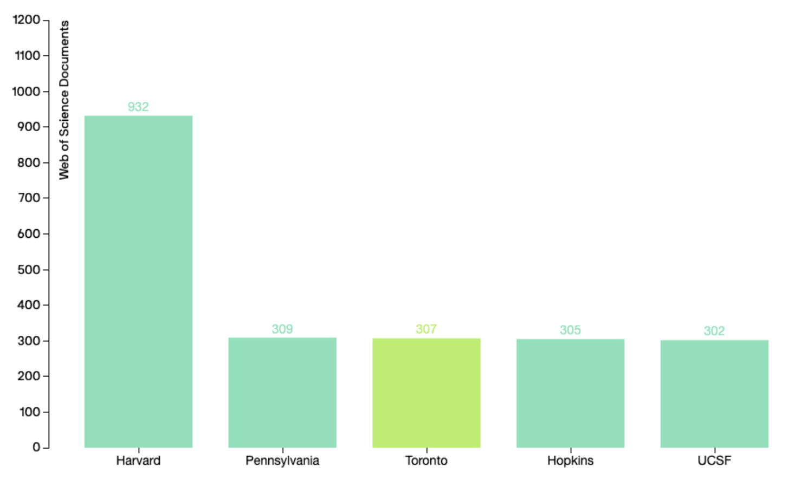
Articles in Top Journals (World)
Number of publications in the 50 highest impact journals in medicine and related fields.
Source: Web of Science, 2019

Slide 10
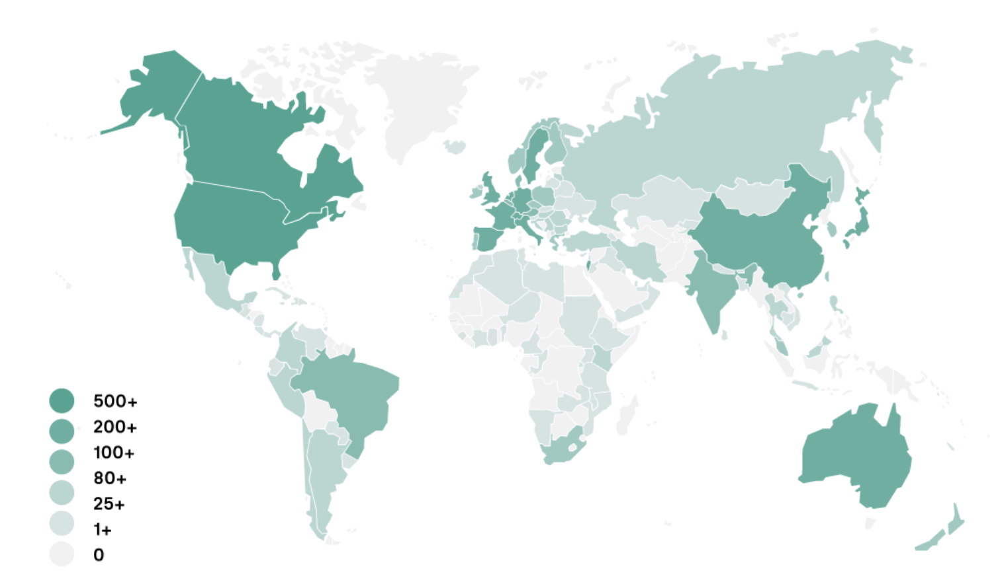
International Collaborations
U of T Medicine researchers collaborate with researchers all over the world. Last year, they co-authored more than 17,500 papers with researchers in 152 counties ranging from Albania to Zambia.

Slide 11
Alumni and Donors
The Faculty of Medicine benefits from the generous financial support of alumni and donors.
These funds help drive programs and research, as well as faculty and student support.
61,302
alumni worldwide
donors in FY 2019–20 (34% first-time donors)
total philanthropic commitments in FY 2018–19
pledged by 1,614 alumni in FY 2018-19, representing 81% of donors
1,983
$75,525,347
$7,512,597

Slide 12
Enrolment Numbers
U of T is home to the third largest MD Program by enrolment in Canada and the largest in Ontario. U of T has, however, the most post-MD trainees in Canada and is a leading provider of medical continuing professional development. Our graduate students are 62% female and represent more than 14.5% of all graduate students at U of T.

Slide 13
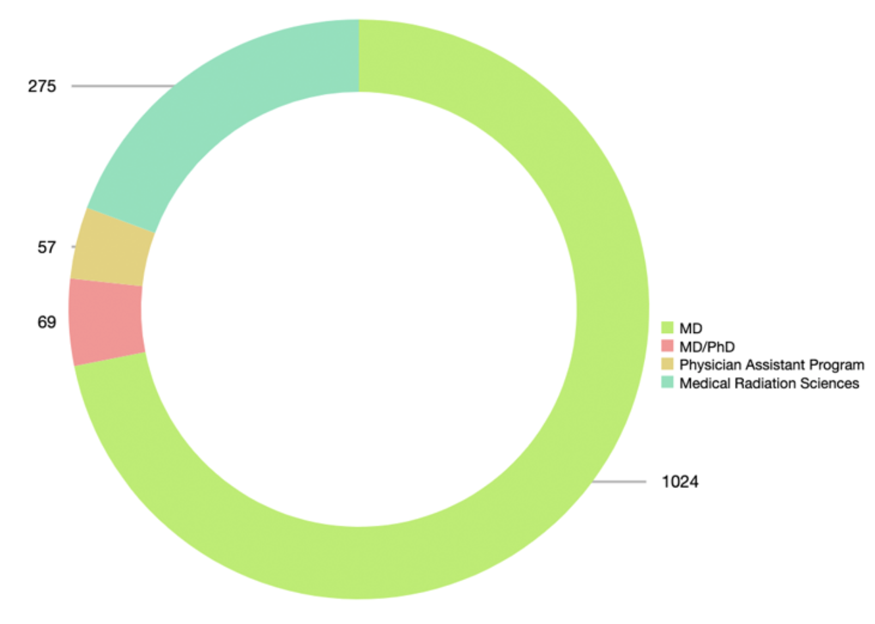
Enrolment Numbers
Undergraduate Learners: 1,425

Slide 14
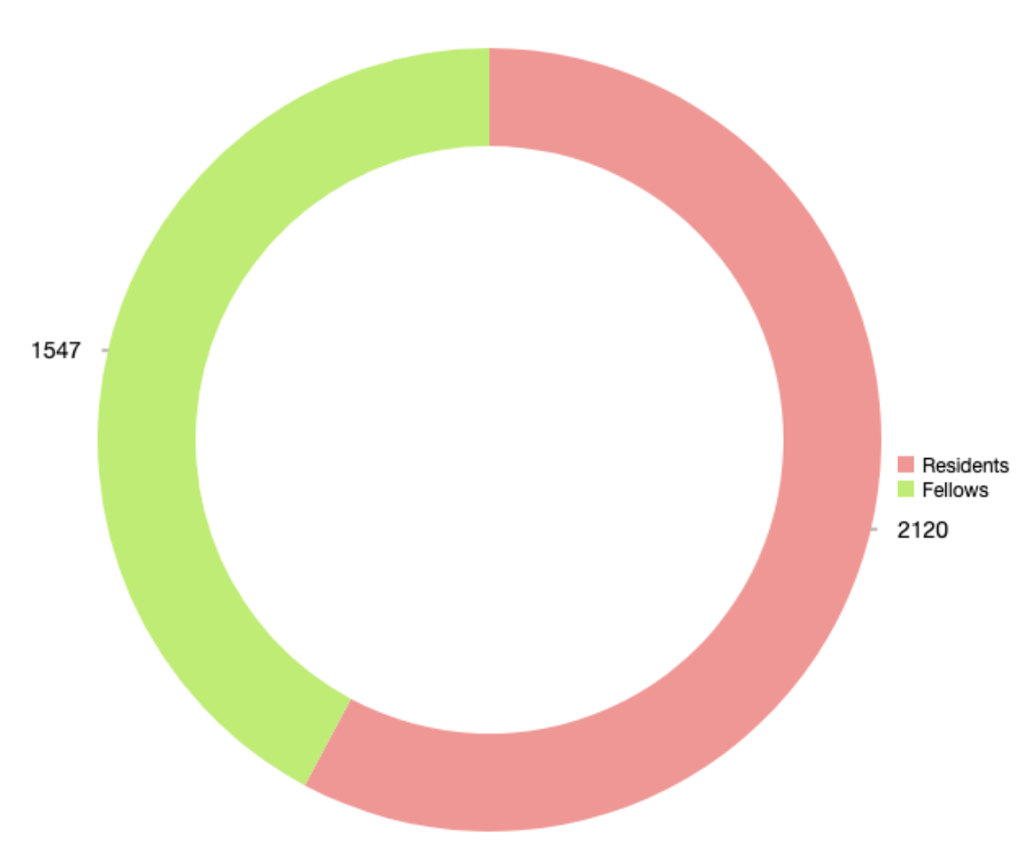
Enrolment Numbers
Post MD Education: 3,667

Slide 15
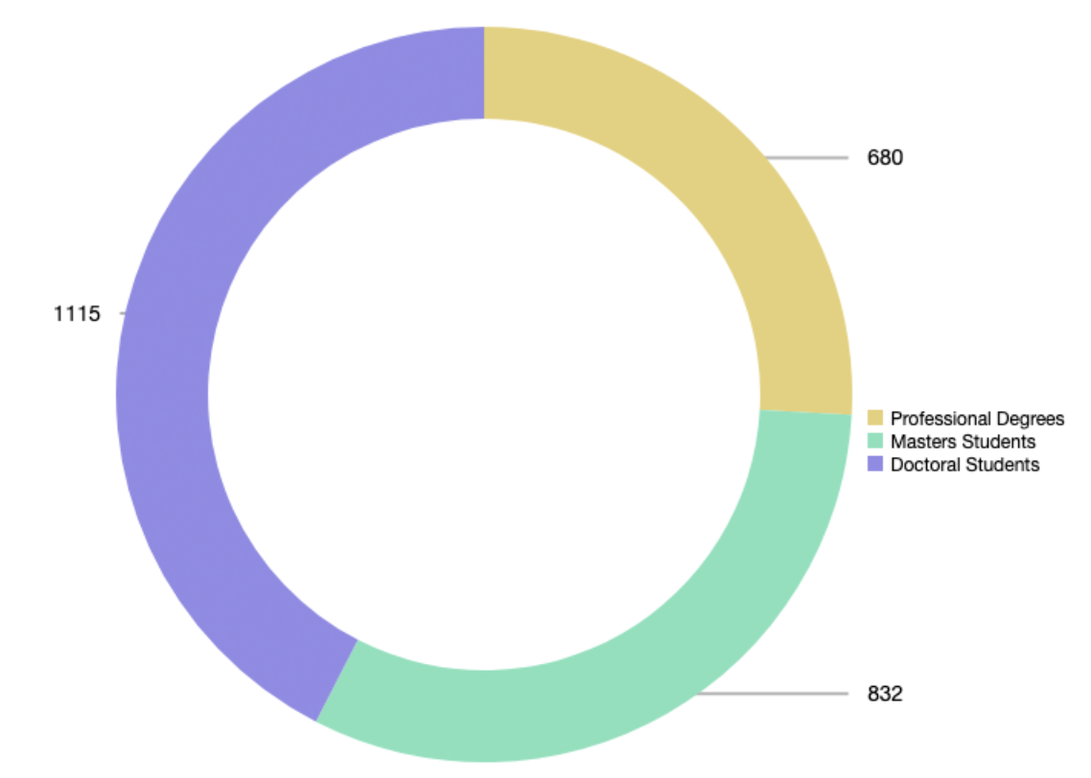
Enrolment Numbers
Graduate Learners: 2,627

Slide 16
Enrolment Numbers
Continuing Professional Development
48,434
learners participated in
accredited CPD events and courses
307

Slide 17
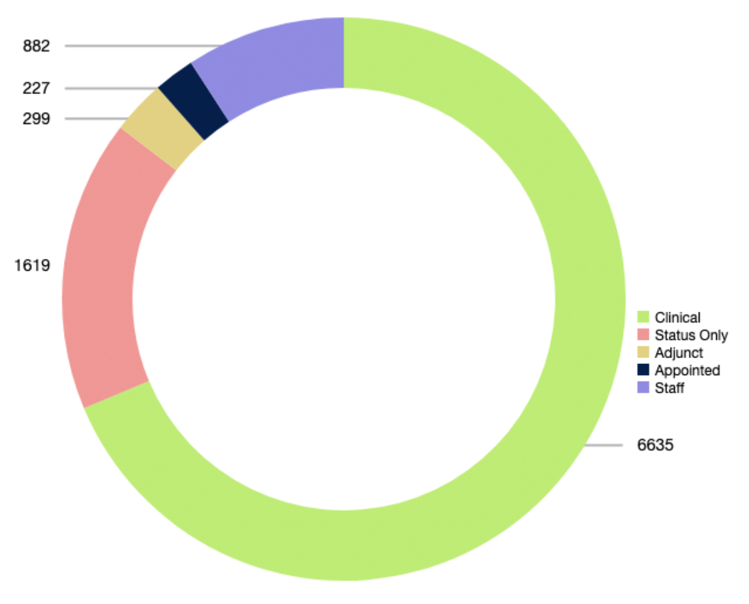
Faculty and Staff: 9,662

Slide 18
Toronto Academic Health Science Network Hospitals and Other Affiliated Institutions
The Faculty of Medicine and our affiliated hospitals form one of the leading health sciences centres for research and education in North America.
The hub centres on the Toronto Academic Health Science Network (TAHSN) – nine teaching hospitals fully affiliated with U of T and four associate member institutions – and extends to another 20 community-affiliated hospitals and healthcare sites in the Greater Toronto Area and beyond.

Slide 19
Toronto Academic Health Science Network Hospitals and Other Affiliated Institutions

Slide 20
Toronto Academic Health Science Network Hospitals and Other Affiliated Institutions
TAHSN Members/Full Affiliation
Baycrest Centre for Geriatric Care
Centre for Addiction and Mental Health
Holland Bloorview Kids Rehabilitation Hospital
Hospital for Sick Children
Sinai Health System
St. Michael’s Hospital Site*
Sunnybrook Health Sciences Centre
University Health Network
Women’s College Hospital
The University of Toronto
TAHSN Associate Members
Michael Garron Hospital
North York General Hospital
St. Joseph’s Health Centre Site*
Trillium Health Partners
(*) These hospitals merged in 2017; the University’s affiliations continue on a site-specific basis.

Slide 21
Toronto Academic Health Science Network Hospitals and Other Affiliated Institutions
Community Affiliates
Humber River Hospital
Lakeridge Health
Markham-Stouffville Hospital
Ontario Shores Centre for Mental Health Sciences
Providence Healthcare Site*
Royal Victoria Regional Health Centre
The Scarborough and Rouge Hospital
Southlake Regional Health Centre
Waypoint Centre For Mental Health Care
West Park Healthcare Centre
William Osler Health System
Clinical (non-Hospital)
Site Affiliations
Canadian Blood Services
George Hull Centre for Children and Families
The Kensington Eye Institute
The Kensington Health Centre
Ontario Forensic Pathology Service
SickKids Centre for Community Mental Health**
Surrey Place Centre
Youthdale Treatment Centres
Other Affiliates
City of Toronto / Toronto Public Health
Public Health Ontario
(*) These hospitals merged in 2017; the University’s affiliations continue on a site-specific basis.
(**) Formerly Hincks-Dellcrest Treatment Centre, this site integrated with the Hospital for Sick Children in 2017; the University’s affiliations continue on a site-specific basis.

Slide 22

University of Toronto
Faculty of Medicine
6 Queen’s Park Crescent West
Suite 122
Toronto, Ontario
Canada M5S 3H2
For the latest figures and information visit vitals.medicine.utoronto.ca

