Slide 1


Rankings / Research / People / Partnerships

Slide 2
How do we demonstrate we are Canada’s leading faculty of medicine? Through data. From international rankings to research funding and donor support, the new Vitals website at vitals.medicine.utoronto.ca quantifies this Faculty’s impact. These figures will be updated throughout the year to report the most recent data about U of T Medicine.

Slide 3
International Rankings
The Faculty of Medicine at the University of Toronto continues to be ranked the top medical school in Canada, and among the top 20 worldwide. While ranking methodology varies, our strong standing is enabled by our large research output and citations.
#3
2021 National Taiwan University Ranking (Clinical Medicine)
2022 U.S. News & World Report (Clinical Medicine)
2022 Times Higher Education World University Ranking (Clinical, Pre-clinical & Health)
2022 QS World University Ranking (Medicine)
2020 Shanghai Ranking (Clinical Medicine)
#5
#5
#12
#15

Slide 4
Contributions to Physician Supply and Distribution
Source: 2016 Ontario Physician Human Resources Data Centre
U of T is the single largest contributor of physicians in Canada, representing 20% of all newly trained Canadian physicians in 2020. (CAPER 2021). According to the Ontario Physician Human Resources Data Centre (OPHRDC), of all Ontario trained physicians entering practice in this province between 2002 and 2020:
35%
of family physicians who trained in Ontario did so at U of T
of specialists who trained in Ontario did so at U of T
of Ontario trained family physicians and
of specialists in the GTA are U of T graduates
54%
58%
69%

Slide 5
How We Innovate
FY 2017 – FY 2021
220
of 864 new invention disclosures filed at U of T came from Medicine
of 395 new priority patent applications filed by U of T came from Medicine
of 240 US patents issued tied to U of T came from Medicine
of 198 new licenses and options at U of T came from Medicine
of 62 new start-up companies at U of T came from Medicine
64
42
34
9

Slide 6
Research Numbers
Temerty Medicine, including its researchers at TAHSN-affiliated institutes, received nearly $925M in research funding in 2019-20 and saw a 4.2 per cent increase in annual support from Tri-Agency Funding (CIHR, NSERC, SSHRC) from the prior year. Collectively, Temerty Medicine receives roughly one-quarter of all Tri-Agency Funding awarded in Canada. With federal funding envelopes remaining relatively static in recent years, U of T Medicine has continued to diversify and increase funding from other sources, including not-for-profit (5.7% increase from prior year) and industry (24.1% increase from prior year).
8,273
Total Awards in 2019-20
Total Funding (millions)
$925

Slide 7
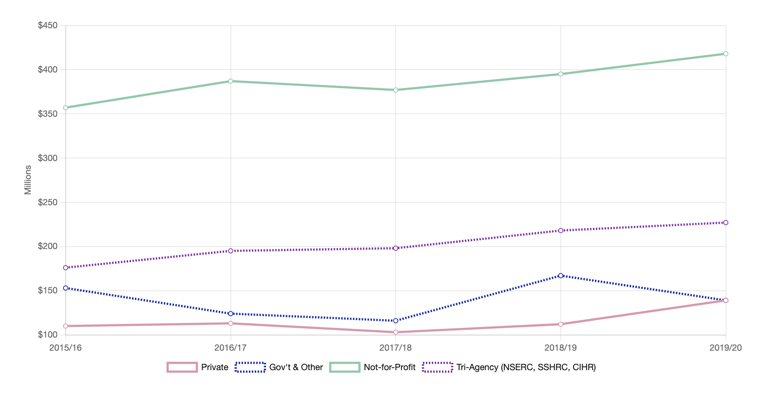
Research Funding Sources

Slide 8
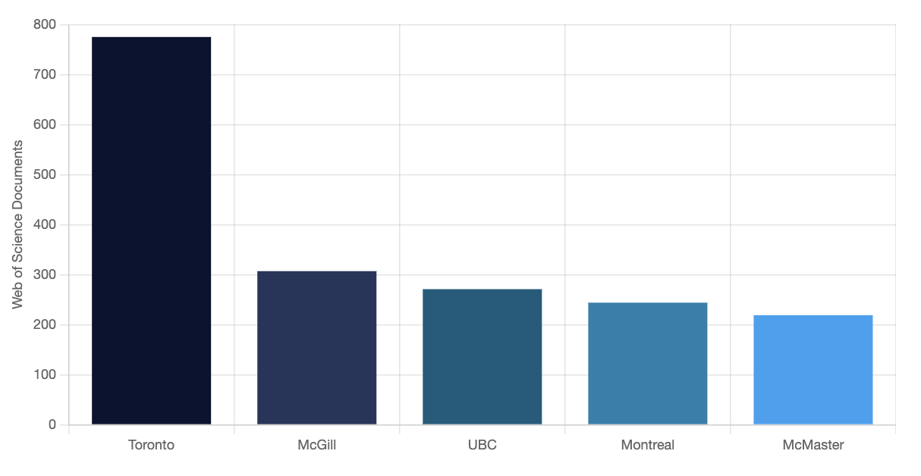
Articles in Top Journals (Canada)
Number of publications in the 50 highest impact journals in medicine and related fields.
Source: Web of Science, 2020

Slide 9
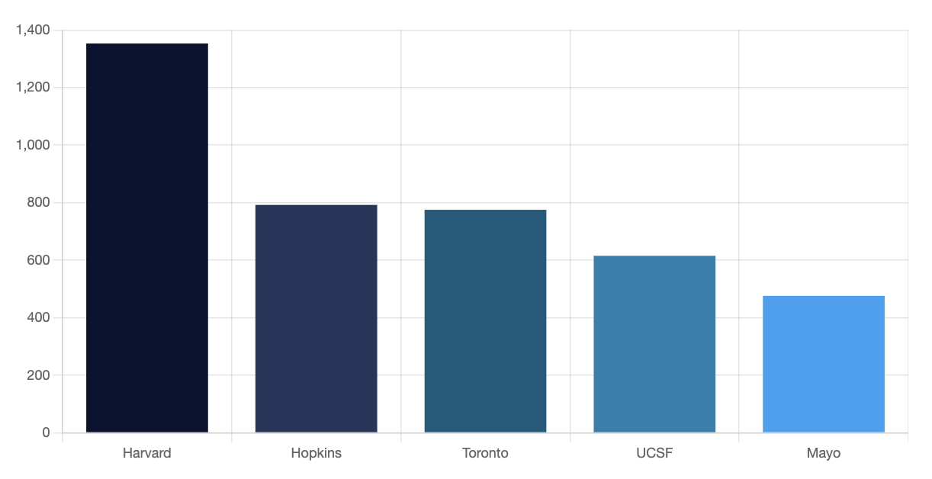
Articles in Top Journals (World)
Number of publications in the 50 highest impact journals in medicine and related fields.
Source: Web of Science, 2020

Slide 10
International Collaborations
Temerty Medicine researchers collaborate with researchers all over the world.
In 2020, our researchers participated in
25,308
Collaborations across
countries, ranging from Albania to Zimbabwe
168

Slide 11
Alumni and Donors
The Temerty Faculty of Medicine benefits from the generous financial support of alumni and donors. These funds help drive programs and research, as well as faculty and student support.
61,698
Alumni worldwide
Donors in FY 2020–21 (50% first-time donors)
Raised (including $240,000,000 from the Temerty Family)
Pledged by 894 alumni
2,463
$288,658,999
$7,304,000

Slide 12
Enrolment Numbers 2020-21
U of T is home to the third largest MD Program by enrolment in Canada and the largest in Ontario. U of T has, however, the most post-MD trainees in Canada and is a leading provider of medical continuing professional development. Our graduate students are 62% female and represent more than 14.5% of all graduate students at U of T.

Slide 13
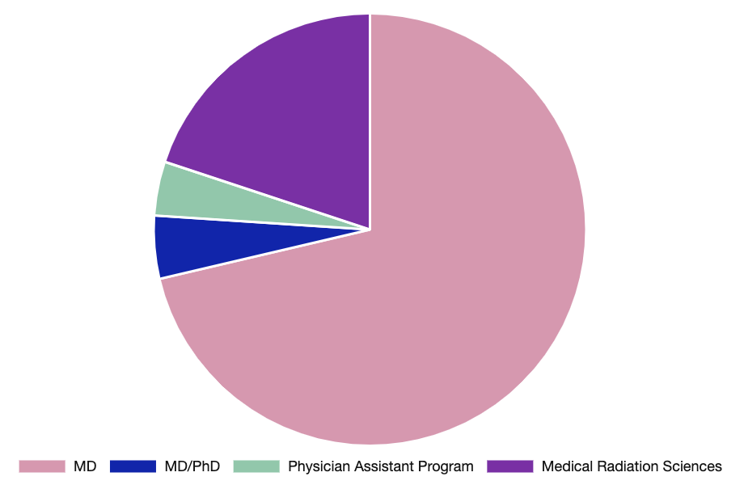
Enrolment Numbers
Undergraduate Learners: 1,486

Slide 14
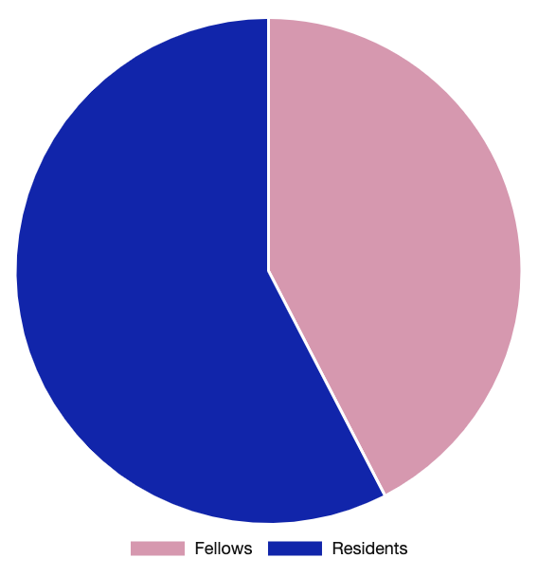
Enrolment Numbers
Post MD Education: 3,693

Slide 15
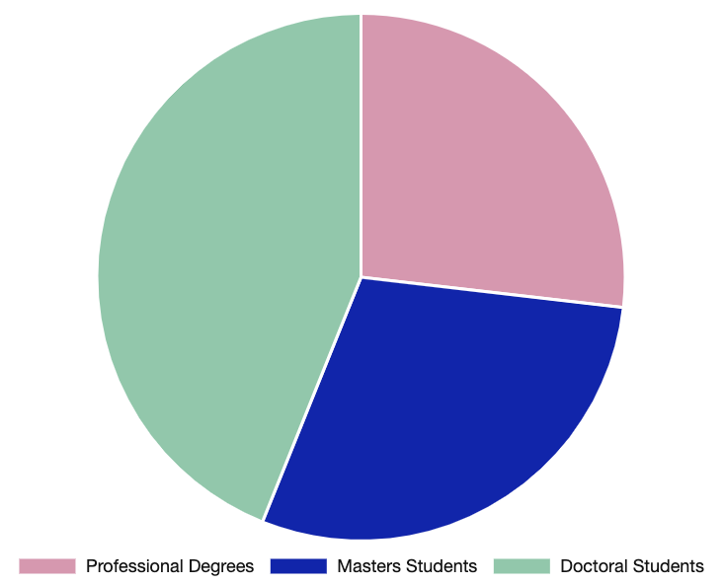
Enrolment Numbers
Graduate Learners: 2,896

Slide 16
Continuing Professional Development
47,202
learners participated in
accredited CPD events and courses
247

Slide 17
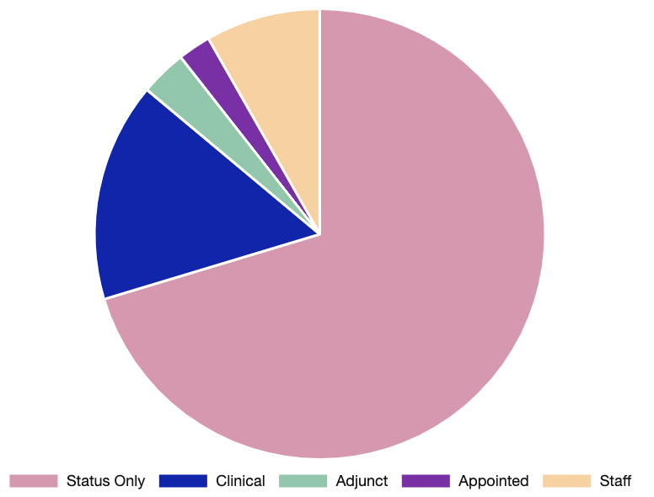
Faculty and Staff

Slide 18
Toronto Academic Health Science Network Hospitals and Other Affiliated Institutions
The Temerty Faculty of Medicine and our affiliated hospitals form one of the leading health sciences centres for research and education in North America. The hub centres on the Toronto Academic Health Science Network (TAHSN) – composed of our fully affiliated and associate affiliated hospitals – and extends to another 20 community-affiliated hospitals and healthcare sites in the Greater Toronto Area and beyond.

Slide 19
Toronto Academic Health Science Network Hospitals and Other Affiliated Institutions
TAHSN Fully Affiliated Hospitals
Baycrest Centre for Geriatric Care
Centre for Addiction and Mental Health
Holland Bloorview Kids Rehabilitation Hospital
Hospital for Sick Children
Sinai Health System
Unity Health Toronto – St. Michael’s Hospital Site*
Sunnybrook Health Sciences Centre
University Health Network
Women’s College Hospital
The University of Toronto
TAHSN Associate Affiliated Hospitals
Michael Garron Hospital
North York General Hospital
Unity Health Toronto – St. Joseph’s Health Centre Site*
Trillium Health Partners

Slide 20
Toronto Academic Health Science Network Hospitals and Other Affiliated Institutions
Community Affiliated Hospitals
Humber River Hospital**
Lakeridge Health
Markham-Stouffville Hospital
Ontario Shores Centre for Mental Health Sciences
Unity Health Toronto – Providence Healthcare Site*
Royal Victoria Regional Health Centre
Scarborough Health Network**
Scarborough and Rouge Hospital
Southlake Regional Health Centre
Waypoint Centre For Mental Health Care
West Park Healthcare Centre
William Osler Health System
Non-Hospital Clinical Site Affiliates
Canadian Blood Services
George Hull Centre for Children and Families
The Kensington Eye Institute
The Kensington Health Centre
Ontario Forensic Pathology Service
SickKids Centre for Community Mental Health***
Surrey Place Centre
Youthdale Treatment Centres
Other Affiliates
City of Toronto / Toronto Public Health
Public Health Ontario
(*) These hospitals merged in 2017; the University’s affiliations continue on a site-specific basis.
(**) These hospitals joined TAHSN in 2021, with their ongoing membership contingent on becoming TAHSN Associate Affiliated hospitals.
(***) Formerly Hincks-Dellcrest Treatment Centre, this site integrated with the Hospital for Sick Children in 2017; the University’s affiliations continue on a site-specific basis.

Slide 21


University of Toronto
Faculty of Medicine
6 Queen’s Park Crescent West
Suite 122
Toronto, Ontario
Canada M5S 3H2
For the latest figures and information visit vitals.medicine.utoronto.ca

